Slide 1
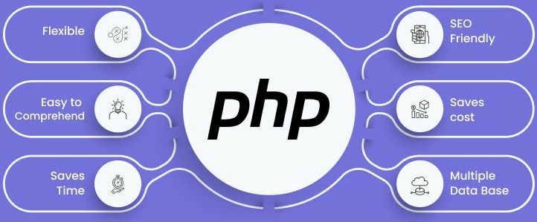

Slide 2
About today…
Frameworks & CMS
Intro
Benefits

Slide 3
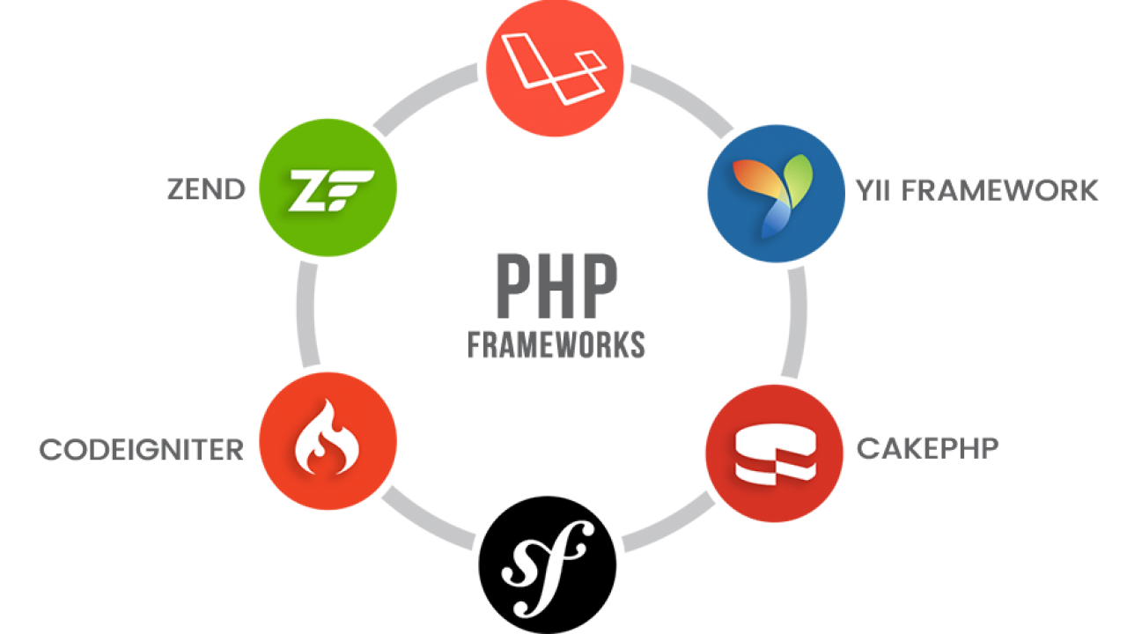

Slide 4
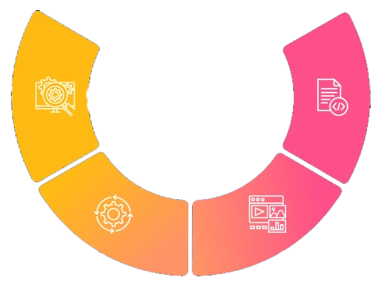
What is a PHP Framework?
Definition
A PHP framework is a platform for developing PHP web applications
Purpose
Provides structure and reusable code to streamline development

Slide 5

Benefits of Using a PHP Framework
Efficiency
Faster development with pre-built modules and libraries
Security
Built-in security features and best practices
Maintainability
Organized codebase, easier to manage and scale
Community Support
Large community for support and resources

Slide 6
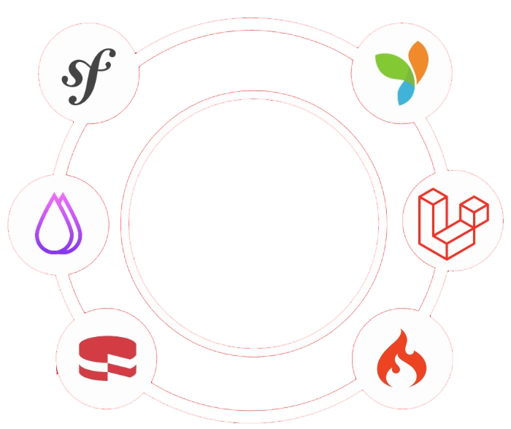
Popular PHP Frameworks
Laravel
Symfony
CodeIgniter
Yii

Slide 7

Laravel Overview
Features
MVC architecture, Eloquent ORM, Blade templating engine
Usage
Suitable for a wide range of applications

Slide 8

Symfony Overview
Features
Reusable components, extensive documentation
Usage
Preferred for complex, large-scale applications

Slide 9

CodeIgniter Overview
Features
Lightweight, easy to learn, minimal setup
Usage
Ideal for small projects and beginners

Slide 10

Yii Overview
Features
High performance, security features
Usage
Best for large-scale web applications

Slide 12
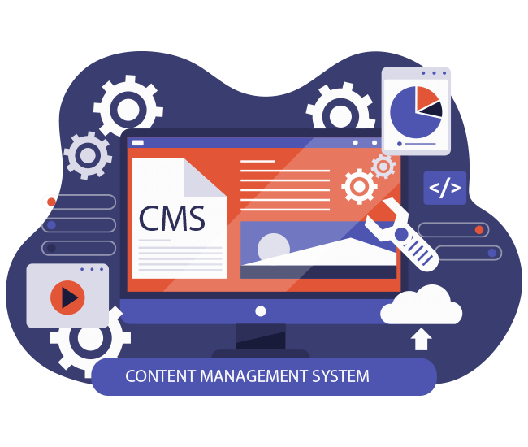
What is a PHP CMS?
Definition
A Content Management System (CMS) is software used to create, manage, and modify digital content
Purpose
Simplifies website management with pre-built templates
and functionalities

Slide 13
Benefits of Using a CMS
Ease of Use
User-friendly interfaces for managing content
Customization
Extensible with plugins and themes
Community Support
Large community for support and resources

Slide 14
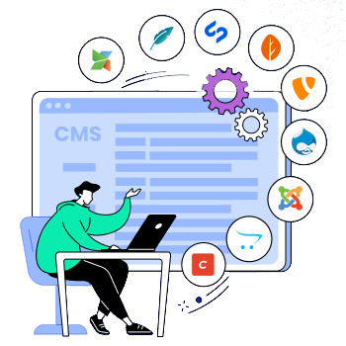
Popular PHP CMS
WordPress
Drupal
Joomla

Slide 15

WordPress Overview
Features
Extensive plugin and theme ecosystem
Usage
Suitable for blogs, e-commerce, and various websites

Slide 16

Drupal Overview
Features
Highly customizable, powerful for complex sites
Usage
Preferred for enterprise-level and high-traffic websites

Slide 17
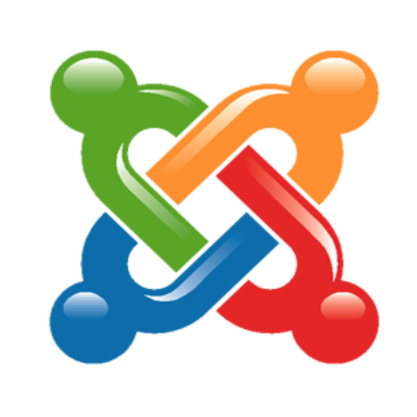
Joomla Overview
Features
User-friendly, versatile
Usage
Suitable for both simple and complex sites

Slide 18

Choosing the right Tool
Factors to Consider
Project requirements
Team expertise
Scalability needs

Slide 19
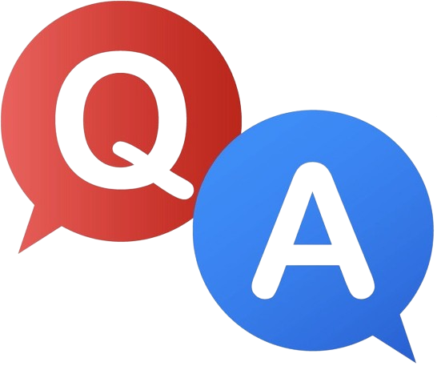

Slide 20

What is a PHP framework?
A platform for developing PHP web applications
Which PHP framework uses the MVC architecture, Eloquent ORM, and Blade templating engine?
Laravel
What is a Content Management System (CMS)?
A software used to create, manage, and modify digital content
Which CMS is known for its extensive plugin and theme ecosystem, making it suitable for blogs and e-commerce websites?
WordPress
Which PHP framework is preferred for complex, large-scale applications and is known for its reusable components?
Symfony

